Slide 1
OPI networking APIs - usecase -

Slide 2
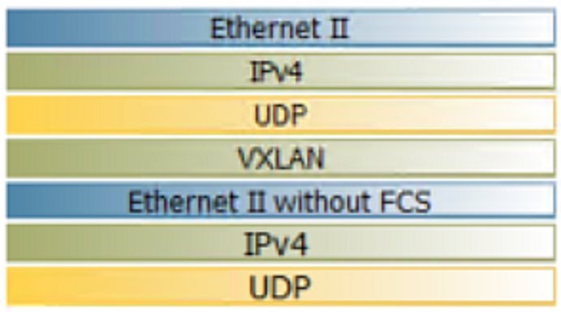
APIs
rpc DeviceCreate (DeviceRequest) returns (DeviceResponse) {} device.proto
Directly connected interfaces:
rpc InterfaceCreate (InterfaceRequest) returns (InterfaceResponse) {} interface.proto
Layer 1 APIs
Layer 2 connectivity (subsequent PR)
Routing to ensure VTEPs are reachable: bgp.proto
rpc BGPCreate (BGPRequest) returns (BGPResponse) {}
rpc BGPPeerCreate (BGPPeerRequest) returns (BGPPeerResponse) {}
rpc BGPPeerAfCreate (BGPPeerAfRequest) returns (BGPPeerAfResponse) {}
Static routing instead of bgp to simplify
VXLAN tunneling:
rpc VnicCreate (VnicRequest) returns (VnicResponse) {} vnic.proto
rpc VPCCreate (VPCRequest) returns (VPCResponse) {}
rpc SubnetCreate (SubnetRequest) returns (SubnetResponse) {}
rpc TunnelCreate (TunnelRequest) returns (TunnelResponse) {}
rpc MappingCreate (MappingRequest) returns (MappingResponse) {}
rpc RouteTableCreate (RouteTableRequest) returns (RouteTableResponse) {}
rpc RouteCreate (RouteRequest) returns (RouteResponse) {}
ACLs policy.proto
rpc SecurityProfileCreate (SecurityProfileRequest) returns (SecurityProfileResponse) {}
rpc SecurityPolicyCreate (SecurityPolicyRequest) returns (SecurityPolicyResponse) {}
rpc SecurityRuleCreate (SecurityRuleRequest) returns (SecurityRuleResponse) {}
https://github.com/opiproject/opi-api/pull/128

Slide 3
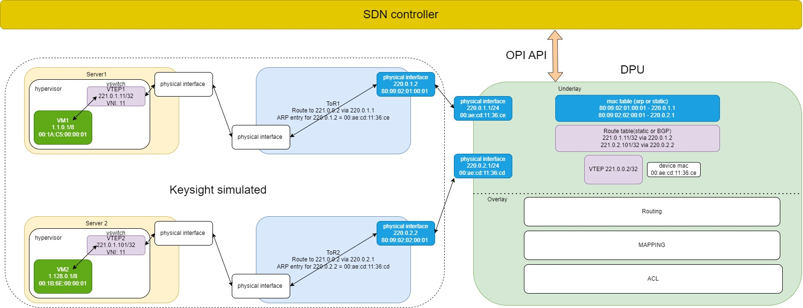
Demo topology

Slide 4
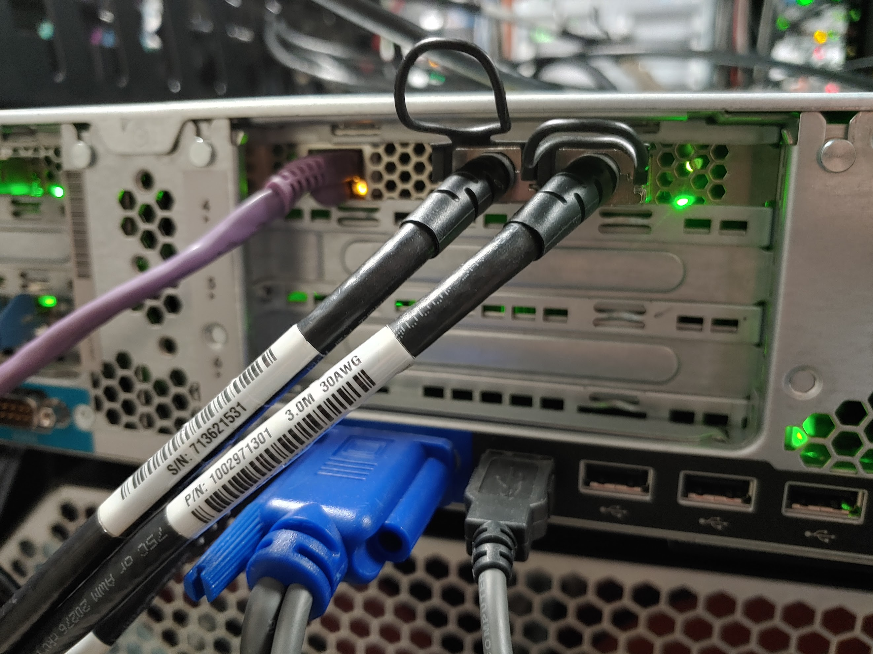
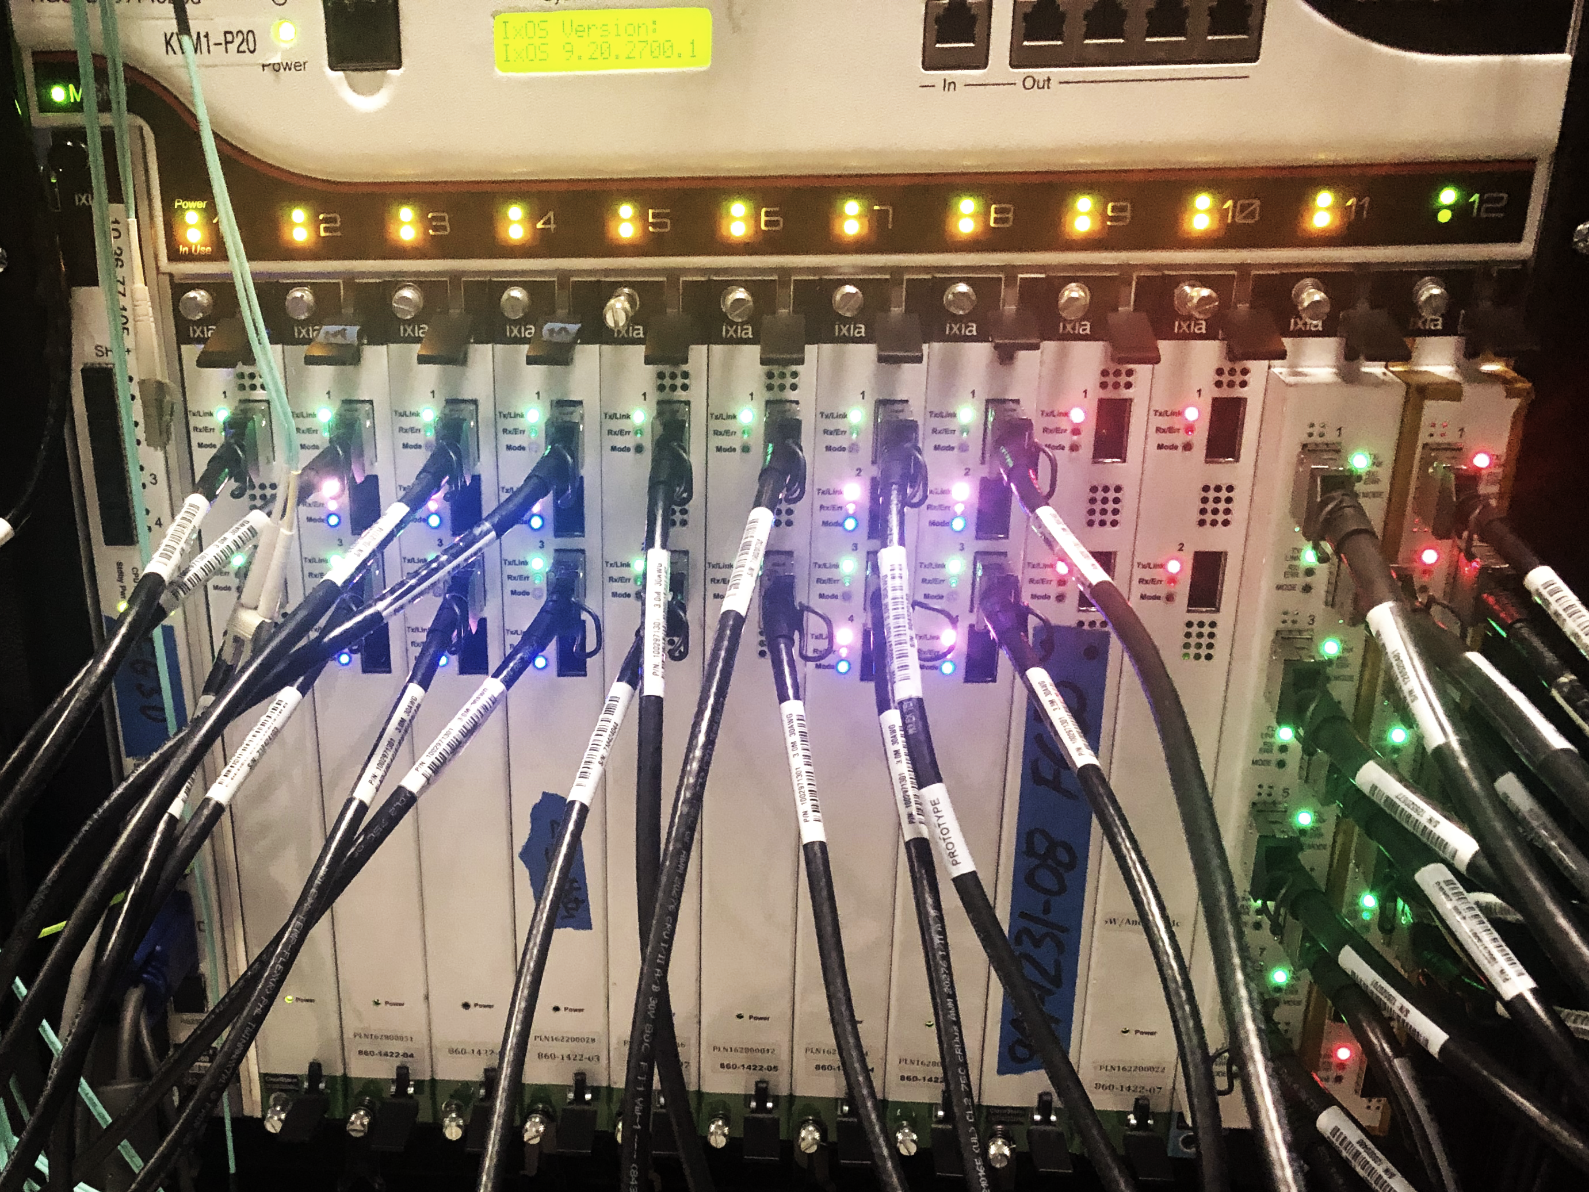
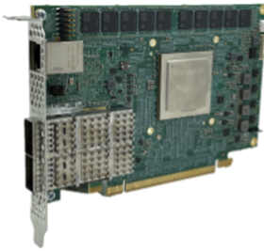
Testbed

Slide 5
DEMO

Slide 6
